Slide 1
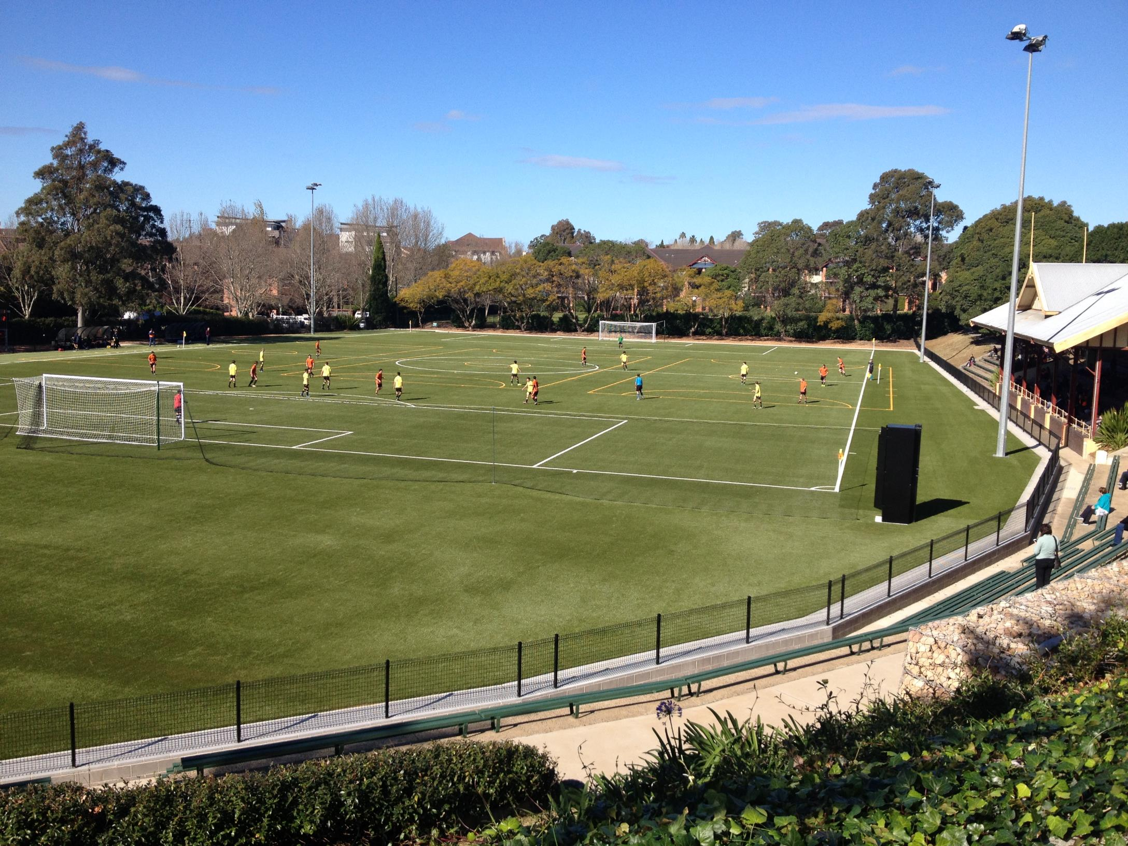
Design and Construction of Arlington Oval
Synthetic Football Pitch
Completed August 2014
LigaTurf Presentation

Slide 2
Arlington Oval, Dulwich Hill – an overview
Existing traditional natural turf football field to be converted to a synthetic field with extent of works as follows:
Strip and dispose existing turf and topsoil
Extensive cut-to-fill of subgrade to agreed design levels and falls
Install new subsurface drainage, married into the existing site infrastructure
Supply and install tree root barrier to isolate field footprint
Supply, place and compact new base pavement
Upgrade of existing sports field lighting
Upgrade of existing edge detail to suit new levels
New fencing to field, retractable netting to northern end of the park
Supply & install LigaTurf synthetic football surfacing system (inc shockpad)
Linemarking for football field, coaches boxes, three Futsal fields
Supply and installation of equipment such as goal posts, dugouts
Maintenance of the field upon completion for a period of two years

Slide 3
Arlington Oval, Dulwich Hill – project challenges
Sensitive development with extensive community objection delaying start by several years
Sign on fence outside oval “Stop this proposed development”
Field surrounded by residential housing and a committee formed to consult with Council
During site evaluation
Football club representatives say “John Warren played on this historical ground”
Heavy rainfall ensured drainage issues to be abundantly clear
On-site storage and field access extremely limited
Trees at the southern end to be retained, root barrier required, potential algae / moss issue
Geotechnical report provided did not identify soil condition which was found to be contaminated
Black recycled rubber granule performance infill was not wanted by Marrickville Council
Savage winds hit whilst we were separating excavated materials to minimise disposal costs

Slide 4
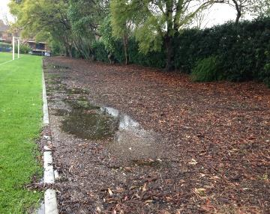
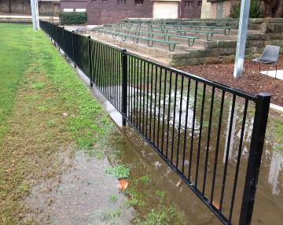
Site issues
Trees at southern end
Field drainage issues

Slide 5
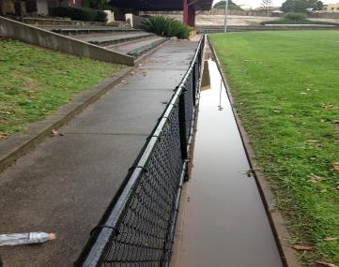
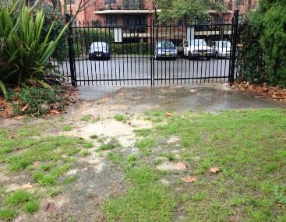
Site issues
Low SW corner of the field
Limited access and storage

Slide 6
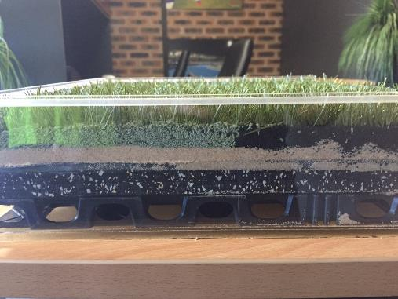
LigaTurf surfacing system profile
LigaTurf RS+ 240 COOLplus synthetic grass
Kiln dried sand stabilisation infill layer
Bionic Fibre EPDM performance infill layer
Elastic Layer shockpad
(drainage cell – not here)

Slide 7
Arlington Oval, Dulwich Hill – project learnings
Community consultation should include the successful contractor before start
Soil classification should be done prior to tender to better determine budget costs
Closer attention needed to dust suppression in a close residential community
Linemarking of the Futsal fields could have been painted or external sidelines to coincide with main field sideline
Penalty spot inserts are excellent inclusion for community fields with open access
EPDM infill should be green, not brown
Would likely recommend 50mm pile height synthetic grass for similar fields

Slide 8
For additional information
Polytan Asia Pacific Pty Ltd
Factory 2 – Dunlopillo Drive Dandenong VIC 3175
1800 663812
m. 0417 224870
e. rob.kirkwood@polytan.com.au
w. www.polytan.com.au
Advanced Polymer Technology Asia Pacific Pty Ltd
Factory 3 – Dunlopillo Drive Dandenong VIC 3175
+61 3 8792 8000
Don’t forget us on Facebook and twitter

